Slide 1
Axle Informatics Team 3
Academic Paper Embedding Pipeline
AI Studio Final Presentation
Virtual
December 6, 2024
Notes:
Kushal: hi, we are axle informatics team 3, Our project topic is Academic paper embedding pipeline.

Slide 2
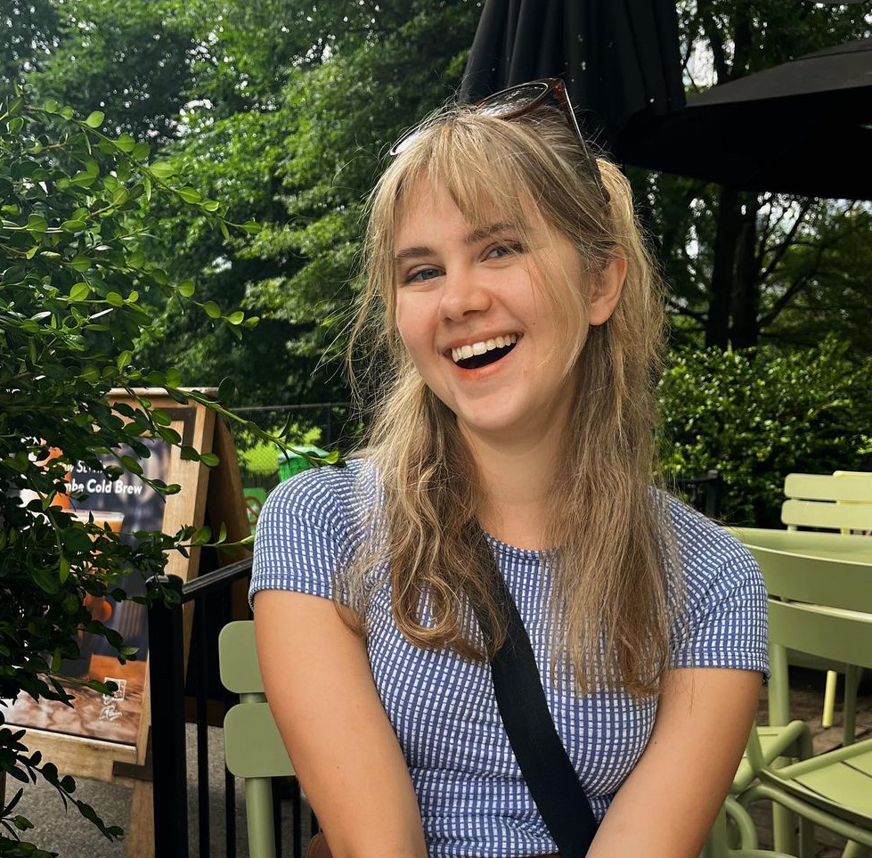


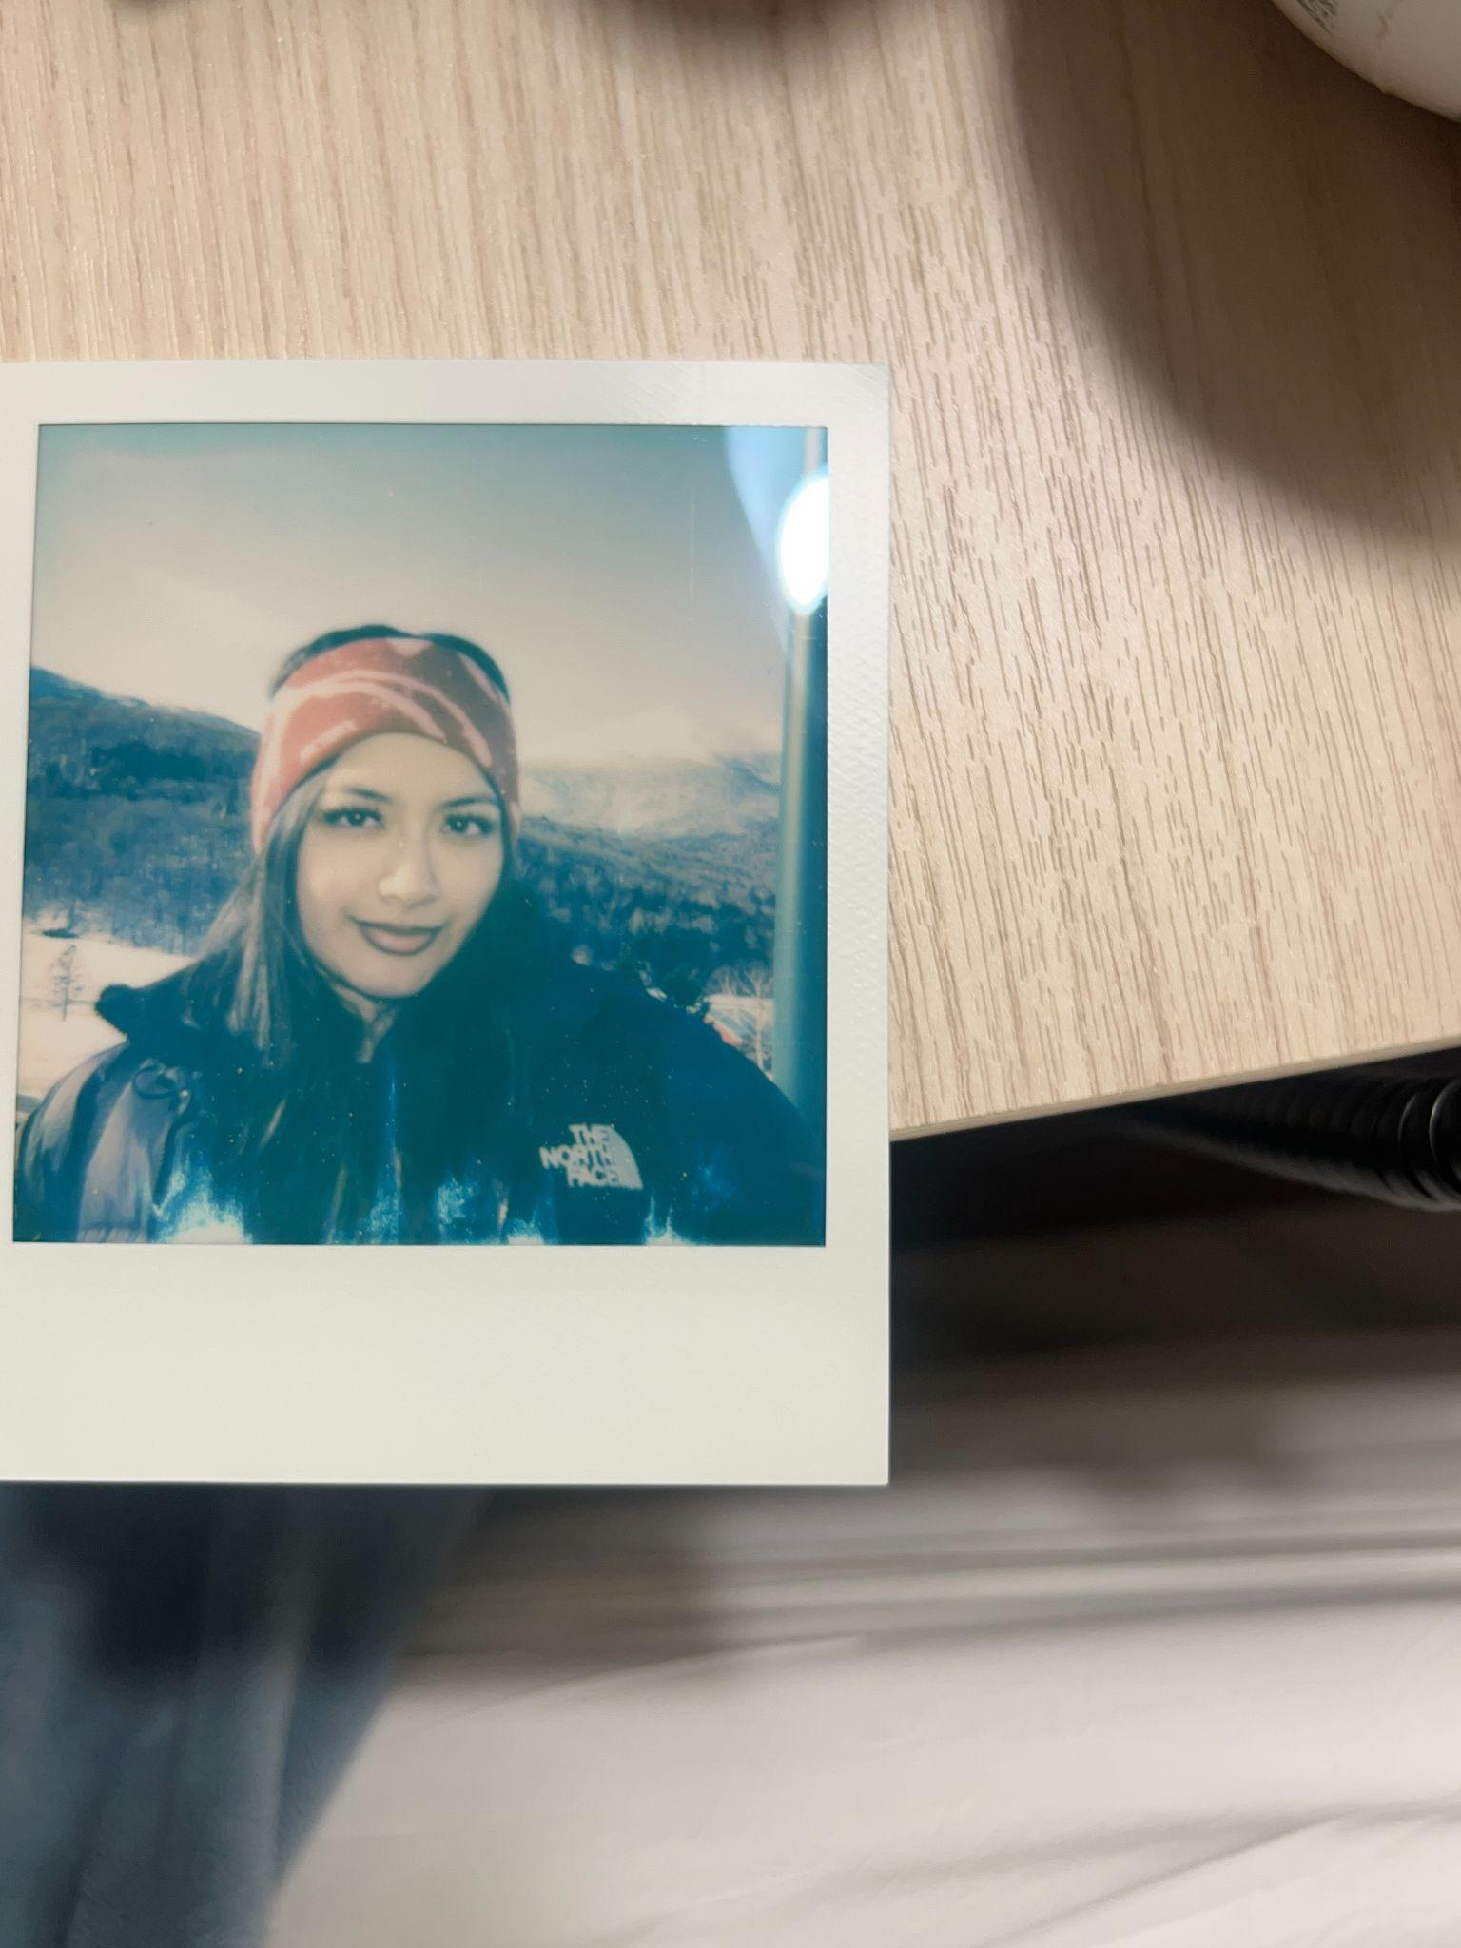
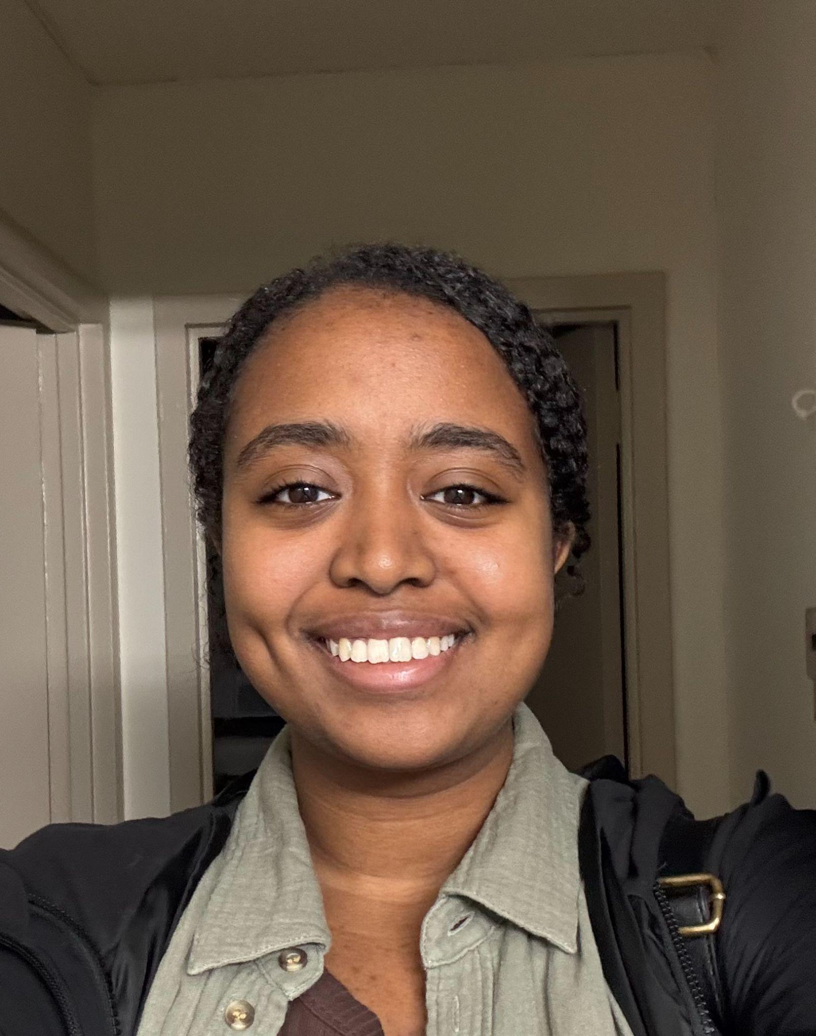
Meet Our Team!
<insert jpg>
<insert jpg>
<insert jpg>
Ivy Brundege Virginia Tech
Vivian Zheng Stony Brook
Kushal Chhetri Virginia Tech
<insert jpg>
Nicole Rodriguez CUNY Baruch
Mohani Adem CUNY City College
Notes:
Everyone

Slide 3


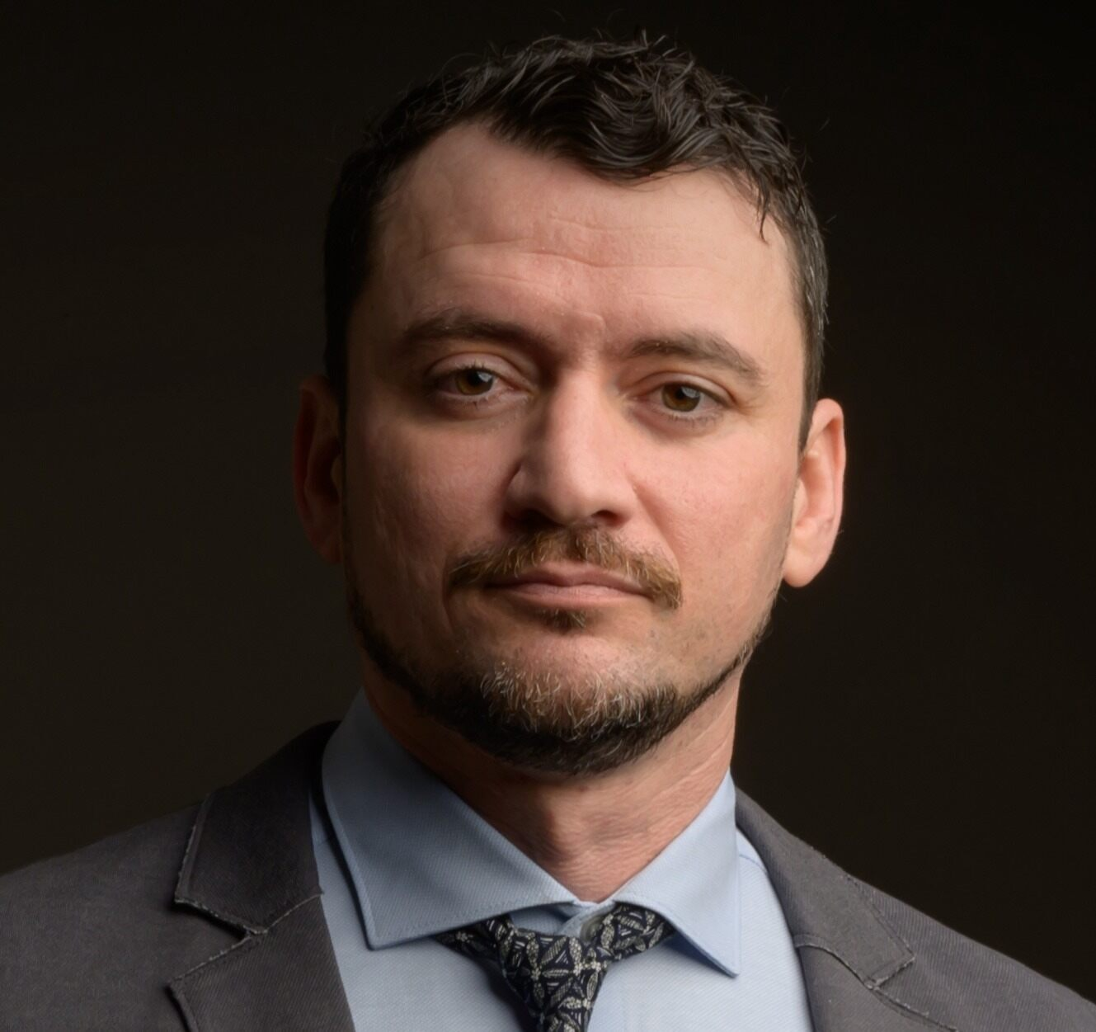

Our AI Studio TA and Challenge Advisors
<insert jpg>
Jesse Ward AI Studio TA
Dr. Nick Schaub, Ph.D. Challenge Advisor
Antoine Gerardin Challenge Advisor
Camilo Velez
Challenge Advisor
Notes:
Kushal: before we get start I will like to take a min to thank our TA jesse, and our challenge advisor, Nick, Antoine, Camilo for helping us through our journey.

Slide 4
Presentation Agenda
01
02
03
04
AI Studio Overview
Data Understanding & Preparation
Modeling & Evaluation
Final Thoughts
Notes:
Mohani

Slide 5
01
AI Studio Overview

Slide 6

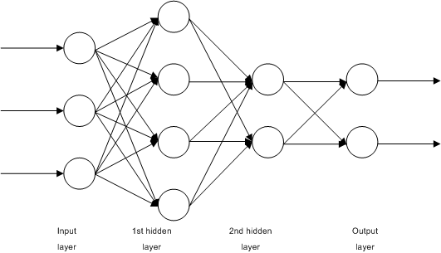
Aa
Notes:
Mohani
The general pipeline for LLM generation starts with some text data, which we then turn into a numerical, vector form in order to train our model. However, a lot of text data is stored in the form of PDFs, which are must be parsed into a text form. This creates a bottleneck in our model development process as it is not a simple process to turn PDFs into the word form we need to generate word embeddings.
In order to train llm -> need large amount text data -> which we’d want to pull from pdfs -> bottle neck bc they need to be parsed since they are not in a pure text format

Slide 7
How can we best convert PDF data to text for a training dataset while maintaining sufficient accuracy?
Notes:
Mohani

Slide 8
Our Goals
Create a PDF parsing procedure to transfer data from arXiv into usable formats for the model
Evaluate parser performance by comparing parsed data to ground truth data
Determine how parsers can be used for the RAG training pipeline
Notes:
ivy

Slide 9
Business Impact
Why do we need good document retrieval?
Academic research requires a high degree of accuracy & verification
Traditional LLM’s can be prone to hallucinations
RAG models add a retrieval step to find relevant source texts
The model then prioritizes these sources when formulating its answer and provides sources for verification
An academic RAG model will allow researchers to get customized, verifiable answers about methodologies, findings, and more.
Notes:
Vivian

Slide 10
Resources We Leveraged
Publicly available data from arXiv
Web-based VSCode through Polus Notebooks Hub
Gsutil
Github repository and project dashboard
PDF Parsing libraries
Traditional OCR
AI
Notes:
Vivian
Some resources we leveraged includes the publicly available dataset from ArXiv.
We used web-based VScode through the polus notebooks hub to write our code in the Gsutil cloud service
We used out github repository and project dashboard to collaborate and keep track of our tasks.
We also used multiple pdf parsing libraries, including both traditional ocr and ai models.

Slide 11
02
Data Understanding & Data Preparation

Slide 12
arXiv Dataset
Foundational open-access archive, with articles covering areas like physics, computer science, mathematics, and more.
Supports research accessibility by offering a free, machine-readable dataset for analysis and machine learning applications.
~2.4 million pdfs and 7 terabytes of data
Pulled PDFs from dataset using Gsutil
Notes:
Mohani

Slide 13
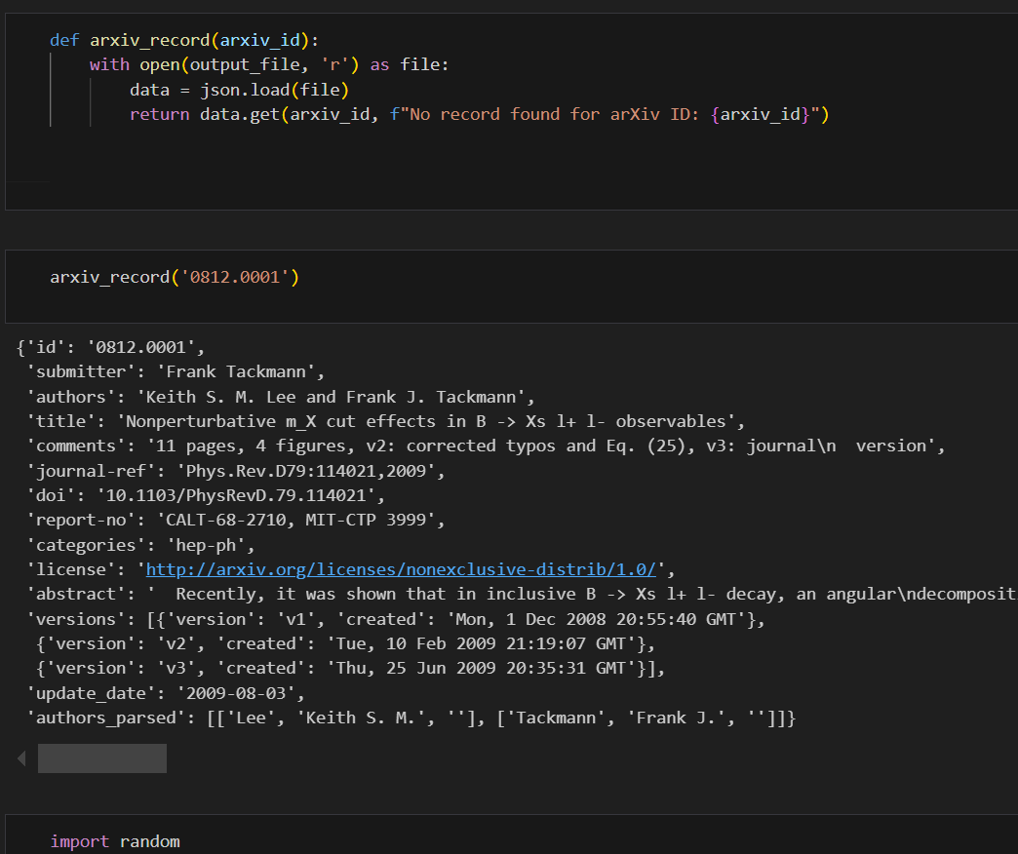
Parsing Metadata and Retrieval Function
Parsed JSON metadata from Kaggle , creating a new JSON file where the arXiv IDs are keys, and values are the associated records
Created a function that takes an arXiv ID and returns the associated record
Created a function that randomly selects 100 random arXiv IDs from papers published in 2024
Notes:
Mohani
Most important parts of metadata for us was the id, abstract, and update-date

Slide 14
03
Modeling & Evaluation

Slide 15
Overview
Each fellow picked a traditional OCR and an AI model parser to test using a test set of PDFs from the arXiv of dataset.
The aim is for each fellow to parse an individual randomized set of 100 PDFs using each parser.
Notes:
nicole

Slide 16
Selection Criteria
Potential considerations for selection:
Parsing time
Output form: text, markdown, etc.
Handling of special features: images, equations, diagrams, etc.
Parsing accuracy
Notes:
nicole

Slide 17
Parser Overview
Tool | Model Type | Open Source? | Output Form | Supports Equations? | Supports Images? | Supports Tables?
Nougat | Transformer-based AI | Yes | Text, Markdown | Yes | No | Yes
PDFPlumber | Rule-based | Yes | Text, JSON | No | Limited | Yes
Marker | AI-assisted | No | Text, Markdown | Limited | Yes | Yes
PDFMiner | Rule-based | Yes | Text, XML | No | No | Limited
Donut | Transformer-based AI | No | Text, JSON | Yes | Yes | Yes
Claude | Transformer-based AI | No | Text, JSON, Chat | Yes | Yes | Yes
Kosmos | Multimodal AI | No | Text, Visual Output | Yes | Yes | Yes
PyMuPDF | Rule-based | Yes | Text, PDF, Images | Limited | Yes | Limited
Llama Parse | Transformer-based AI | No | Text, JSON, Markdown | Yes | Yes | Yes
DocTR | Vision Transformer | Yes | Text, JSON, Images | Limited | Yes | Limited
Open Parse | AI-assisted | No | Text, JSON, Markdown | Yes | No | Yes
Notes:
Kushal:
Script: So, like Nicole mentioned earlier, we each chose an AI model and a traditional OCR model to analyze. While the traditional OCR tools were relatively similar in their output, the AI models showed much greater variability. To assess these differences, we focused on three main criteria: equations, images, and tables.
Equations:
Academic papers in STEM fields heavily rely on mathematical content. A tool's ability to accurately extract equations ensures the integrity of the data.
Images: Many academic papers include figures, diagrams, and visual data to complement the text. The ability to process and retain these visuals is vital for preserving the context and meaning of the paper.
Tables:
Structured data, often presented in tables, is central to academic research for summarizing findings or presenting datasets. So, the ability to correctly recognize and extract tables ensure that no critical information is lost or misinterpreted.
Some tools excelled in all three areas, while others had limitations the once that are highlighted in red are the once we had to drop, which I will explain in next slide.

Slide 18
Parsers that did not work:
Donut
Requires the PDF file to a JPEG to be usable
Claude
Requires API by sending input (questions or prompts) in the script and receiving responses in return. As well as restrictions and licensing requirements for business use
Kosmos
Requires Flash Attention2 so it only runs on Ampere, Ada, or Hopper GPUs
Notes:
Kushal:
Donut: CAN read low-quality images but we would need to convert the pdf files to a JPEG file to be used (will take a long time + take up alot of storage)
Claude: allows for interaction through an API by sending input (questions or prompts) in the script and receiving responses in return. Decided not to proceed with Claude due to its restrictions and licensing requirements for business use
Kosmos: has a hardware requirement, which we were not able to meet.

Slide 19
Time for Parsing
Marker: ~6.5 sec per pdf
PyMuPDF: ~5-10 sec per pdf
OpenParse: ~3-4 sec per pdf
LlamaParse: ~10-15 sec per pdf
DocTR: 3-4 min per pdf
Nougat: 20-25 min per pdf
Required GPU support for performance
VS
Notes:
Kushal: while doing a cross examination of the parser, we realized a another important criteria, that is the timing for parsing per pdf. Nougat being the worst performer.
We believe the primary reason for Nougat slower performance is the lack of GPU utilization. Unlike Kosmos, which requires a GPU to operate efficiently, Nougat has the flexibility to run on systems without a GPU. However, this flexibility comes at the cost of significantly reduced performance. Tasks like parsing an 8-page PDF can take upwards of 27 minutes on a CPU-only setup, compared to much faster processing times achievable with GPU acceleration.

Slide 20
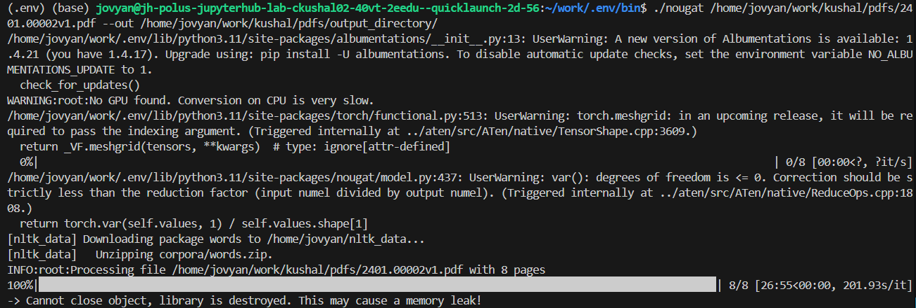
Nougat time issue:
Notes:
Kushal:
We believe the primary reason for Nougat slower performance is the lack of GPU utilization. Unlike Kosmos, which requires a GPU to operate efficiently, Nougat has the flexibility to run on systems without a GPU. However, this flexibility comes at the cost of significantly reduced performance. Tasks like parsing an 8-page PDF can take upwards of 27 minutes on a CPU-only setup, compared to much faster processing times achievable with GPU acceleration.

Slide 21
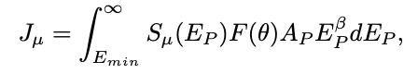
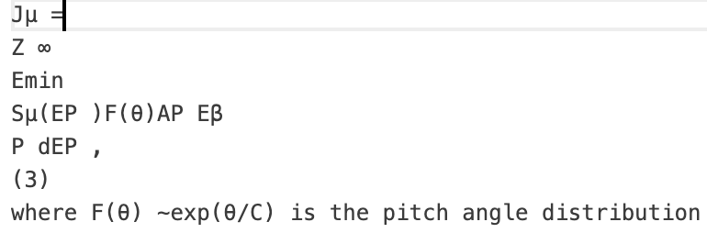
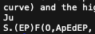
Formatting [Equations]
OpenParse- skips equation; leaves remaining text
PDFPlumber - leads to whole paragraphs being skipped
Original
Nougat
docTR
PyMuPDF
Llama
Notes:
Vivian
So now we will the discuss how different parsers dealt with equations, images, and tables.
For equations,
OpenParse skips equations but leaves remaining text. PDFPlumber will skip whole paragraphs when it encounters an equation.
Below we have a few example outputs of an equation from different parsers.
PyMuPDF is able to print out the text in the equation but does not format the equation.
Nougat print the information in a latex formatting, making it a bit harder to read.
docTR, similarly to Pymupdf, it prints out the text in the equation but does not maintain the structure
Out of all these parsers, LlamaParse is the most successful parser for equations as it is able to parse out the text and correctly format it

Slide 22
Formatting [Images]
Parsers that could parse out images:
Marker
LlamaParse
Parsers that were unable to parse images:
OpenParse
Nougat
PDFPlumber
Other notable parsers:
PyMuPDF: able to parse out but sometimes skips images
PDFMiner: requires separate function
docTR: parses the text from the image but not image itself
Notes:
Vivian
For images:
Marker + LlamaPaese - pngs
PyMuPDF is able to parse out entire images successfully, with each image in a separate png file. For some files, it is noted that it will skip some or all the images in the file.
docTR is able to parse the information from images but not the images themselves
OpenParse is unable to output entire images
TABLES:
Llamaparse- allows embedded
PyMuPDF - ignores, will show error but still continues
OpenParse - parses out pretty accurately but requires a different function for pdfs with tables and those without. Will crash if does not detect table.
docTR: does not parse table
IMAGES:
Llama-
PyMuPDF - parses images out into png file but will only parse out embedded ones, some are ignored
OpenParse - does not parse
docTR- parses text from images
OUTPUT FORMS:
PyMuPDF - txt file, png file,
OpenParse - markdown, parses by splitting text into sections but sometimes the boxed off sections will overlap so certain sections will have their text combined + this messes up the output
docTr: json file
OTHER:

Slide 23
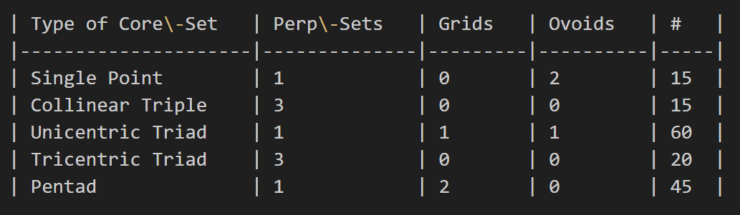
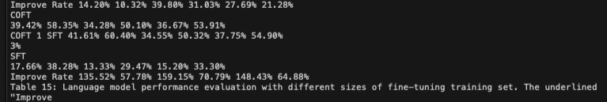
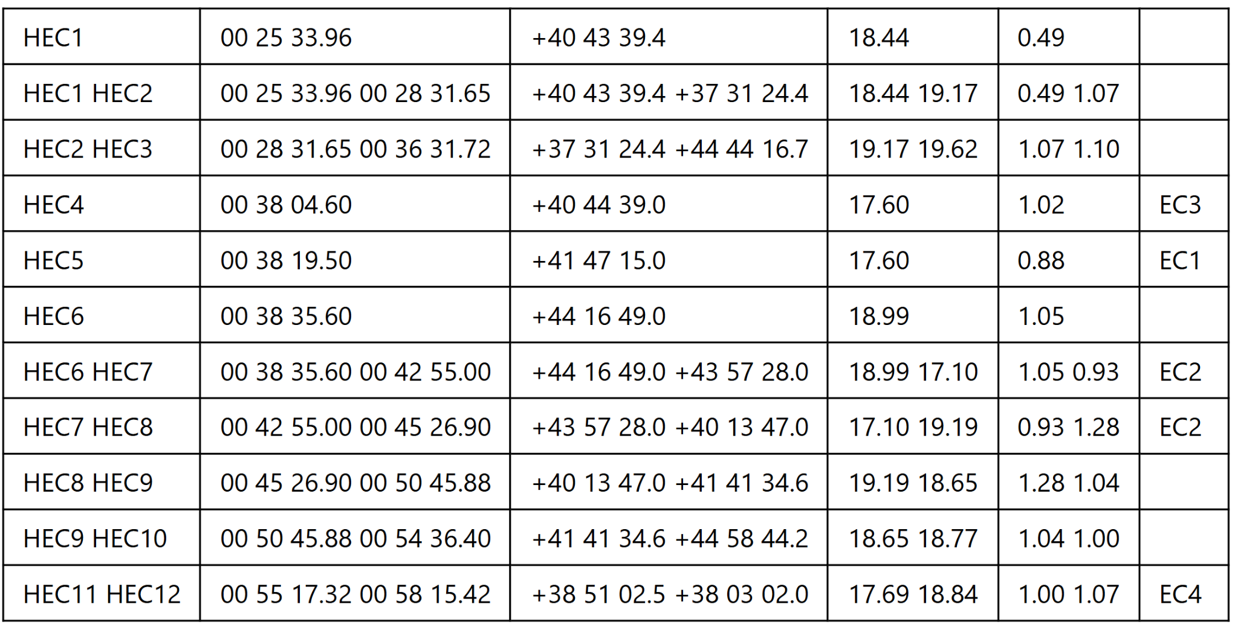
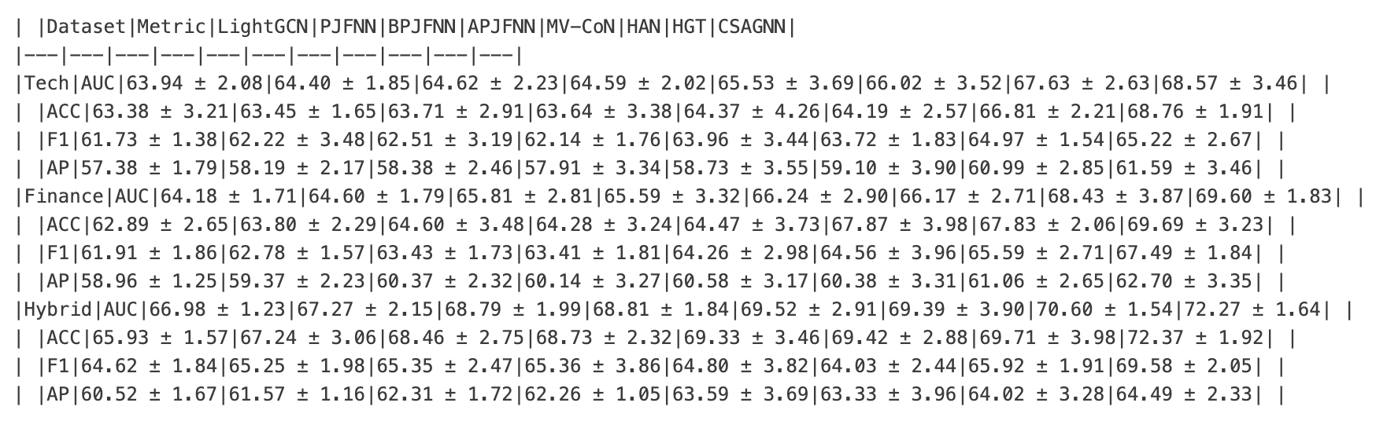
Formatting [Tables]
Marker
docTR
Llama
OpenParse
Notes:
Vivian
Here we can see some sample outputs of tables from different parsers.
docTr: parses the table, and extracts the information in a json format along with the rest of the text. However does not maintain the original structure
As you can see, both marker and LlamaParse are able to parse out formatted tables within the text
OpenParse parses out the tables in standard table formatting and prints it in markdown.
Even though OpenParse is able to parse out tables, if a PDF contains tables and we want to parse it out in the correct format, it requires a different function to parse it out with the text. So it requires different functions for parsing out just text and parsing out text + tables. If a pdf does not have a table but the function for parsing out text and tables is used, the function will crash when it realizes there are no tables in the PDF.
All the other parsers we tested are unable to parse out tables.

Slide 24
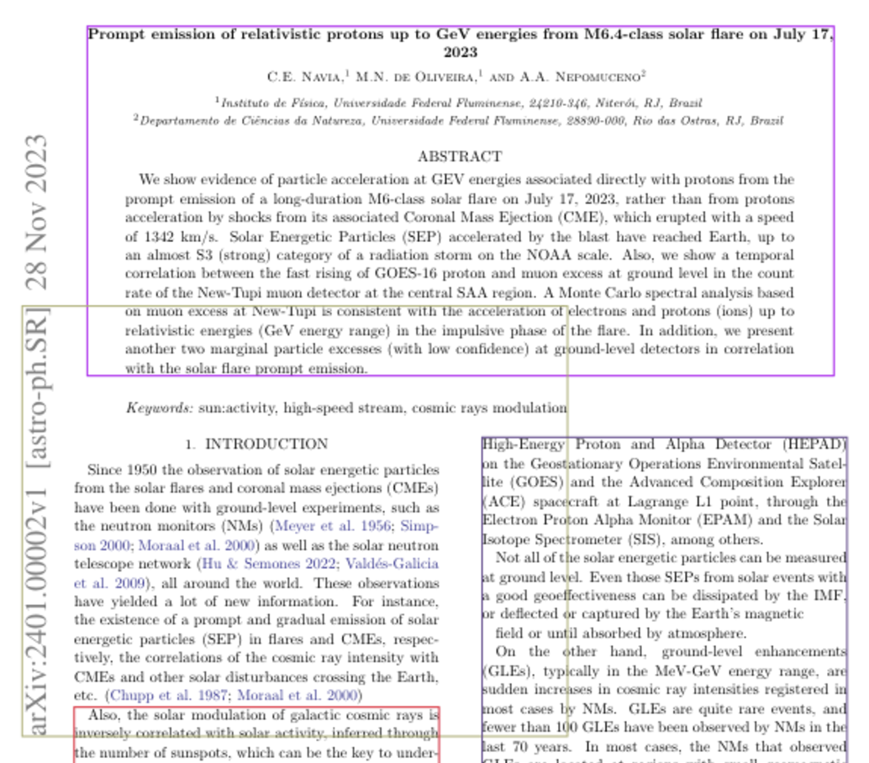
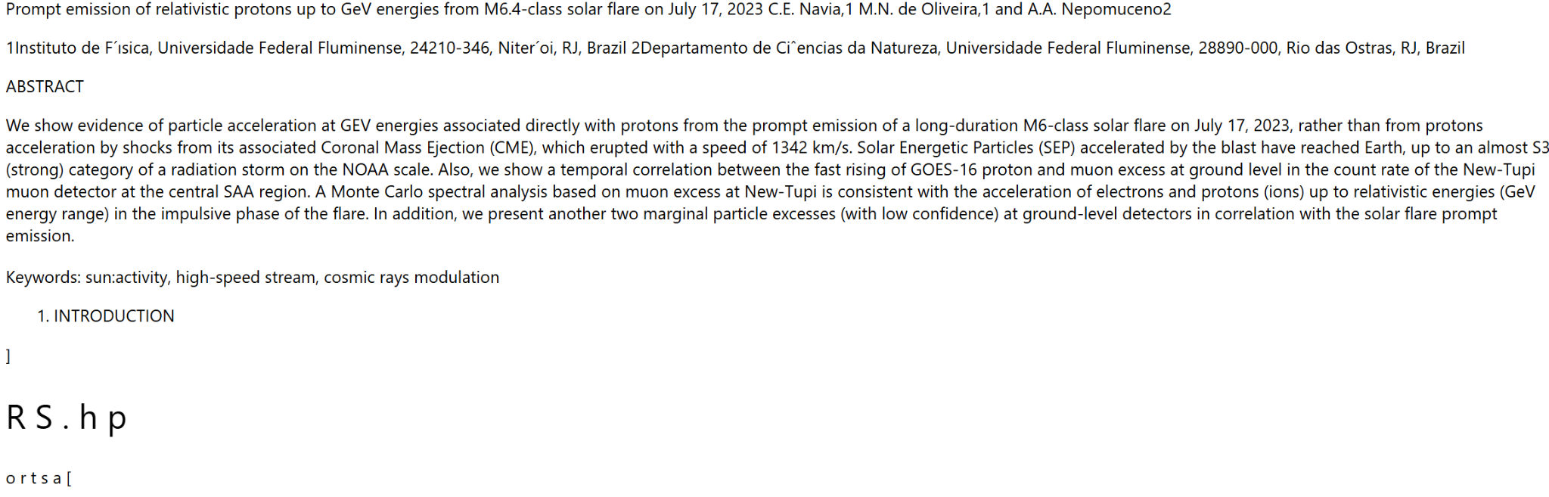
Notable shortcomings
OpenParse - inaccurate text parsing
Parser boxes the text into sections and outputs each section one by one. Sometimes the sections will overlap or cut off before all the text is in the box, resulting in inaccurate text.
Notes:
Nicole
For Notable Shortcomings:
OpenParse faces issues regarding
Its inability to properly parse text accurately
It boxes the text into sections and outputs each section one by one
Sections will often overlap or cut off before all the text is in the box
Issues persist when:
here are lots of equations or images as the pdf is formatted differently from a pdf that is mainly text

Slide 25
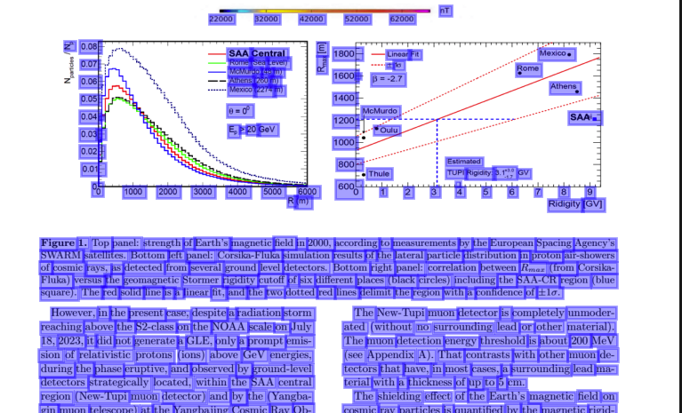
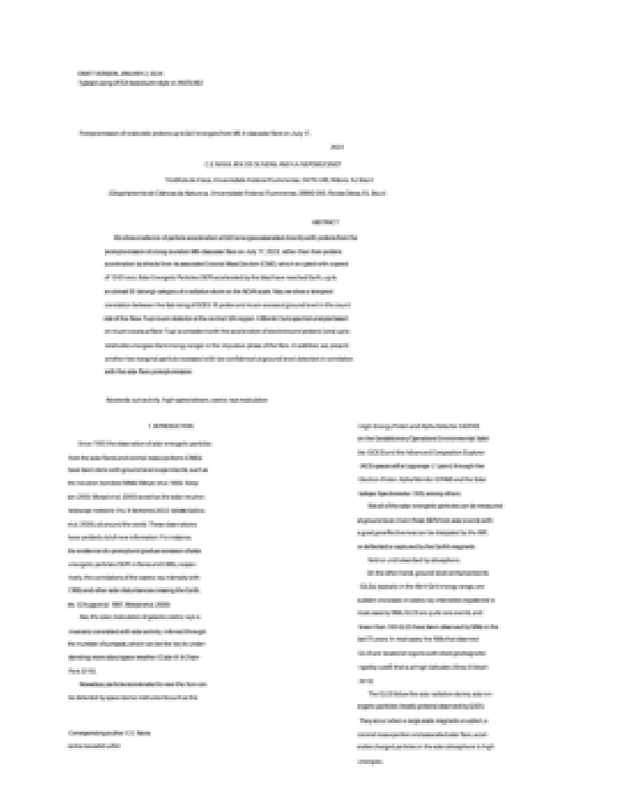
Notable to Mention
docTR
Ability to output highlighted document demonstrating text it was able to detect. As well as outputting a copy of the document and what it had “detected.”
Highlighted Document
Blurry “Copy” of the Document
Notes:
Nicole:
As for a Notable to Mention:
DocTR: proved to have impressive outputs
When parsing a pdf, it had the ability to output the document with the highlighted text it was able to detect
As well as outputting a “copy” of the pdf.
If given more time, I believe docTR allows for fonts to be added so it could create the copy of the pdf much clearer
docTR- After following docTR documentation, the results of parsing the pdfs include an output of the file with all the text detected highlighted, as well as the file reprinted as a “copy” of the file.

Slide 26
Accuracy
Compared word embeddings from the ground-truth abstracts (obtained via arXiv JSON metadata) and the parsed abstracts
Preserves semantic significance
Word embeddings created using Hugging Face’s all-MiniLM0L6-v2 model
Compared word embeddings using cosine similarity to determine semantic differences
Example: “agonist” vs “antagonist” = 90% similarity
Notes:
ivy

Slide 27
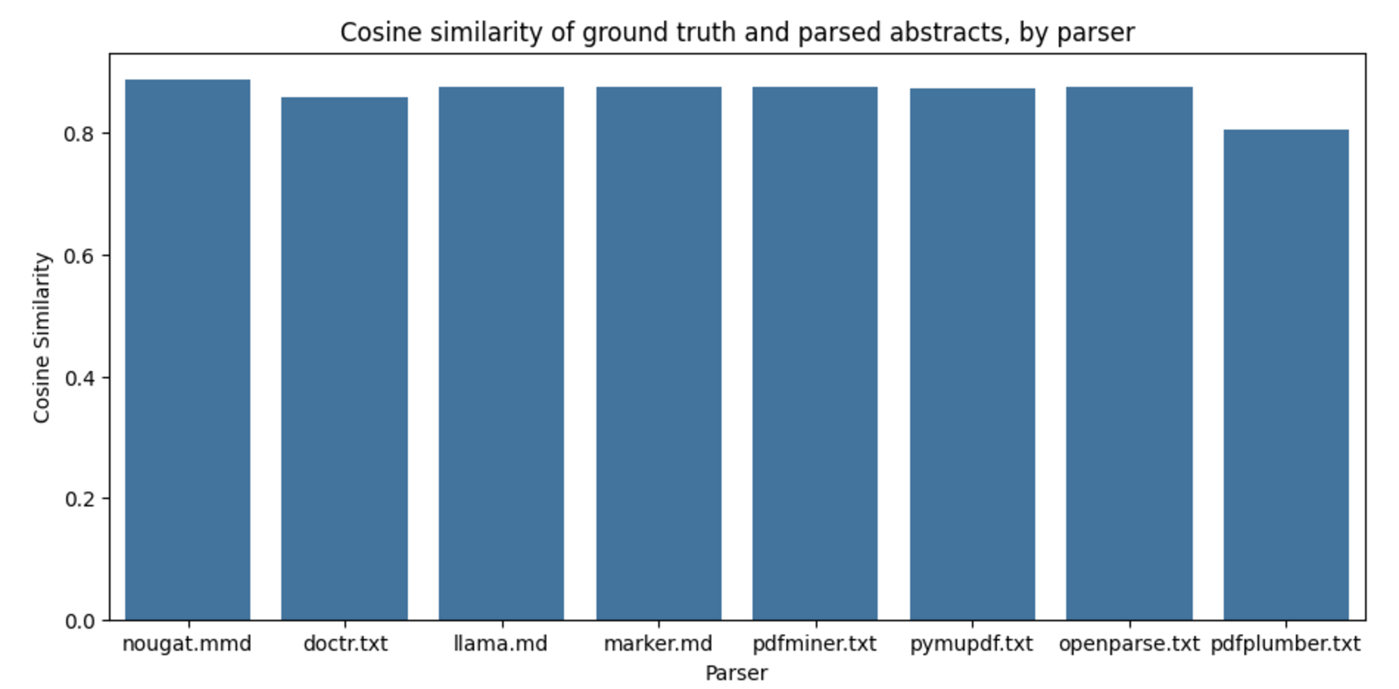
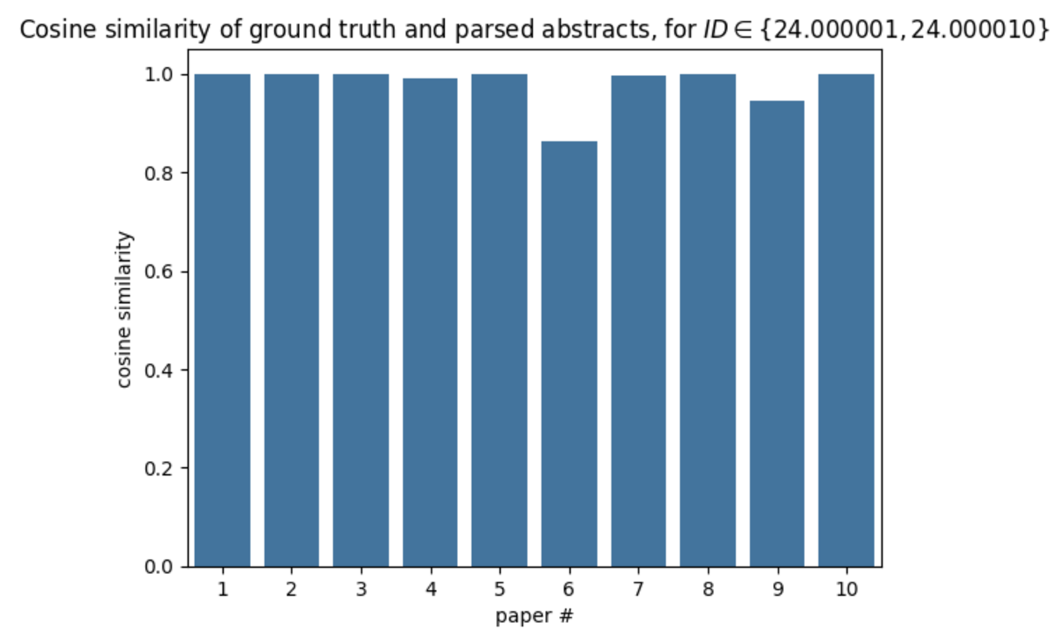
Accuracy (cont.)
All parsers showed >0.9 cosine similarity with ground truth
Replicated: LlamaParse showed a high degree of accuracy
Notes:
ivy

Slide 28
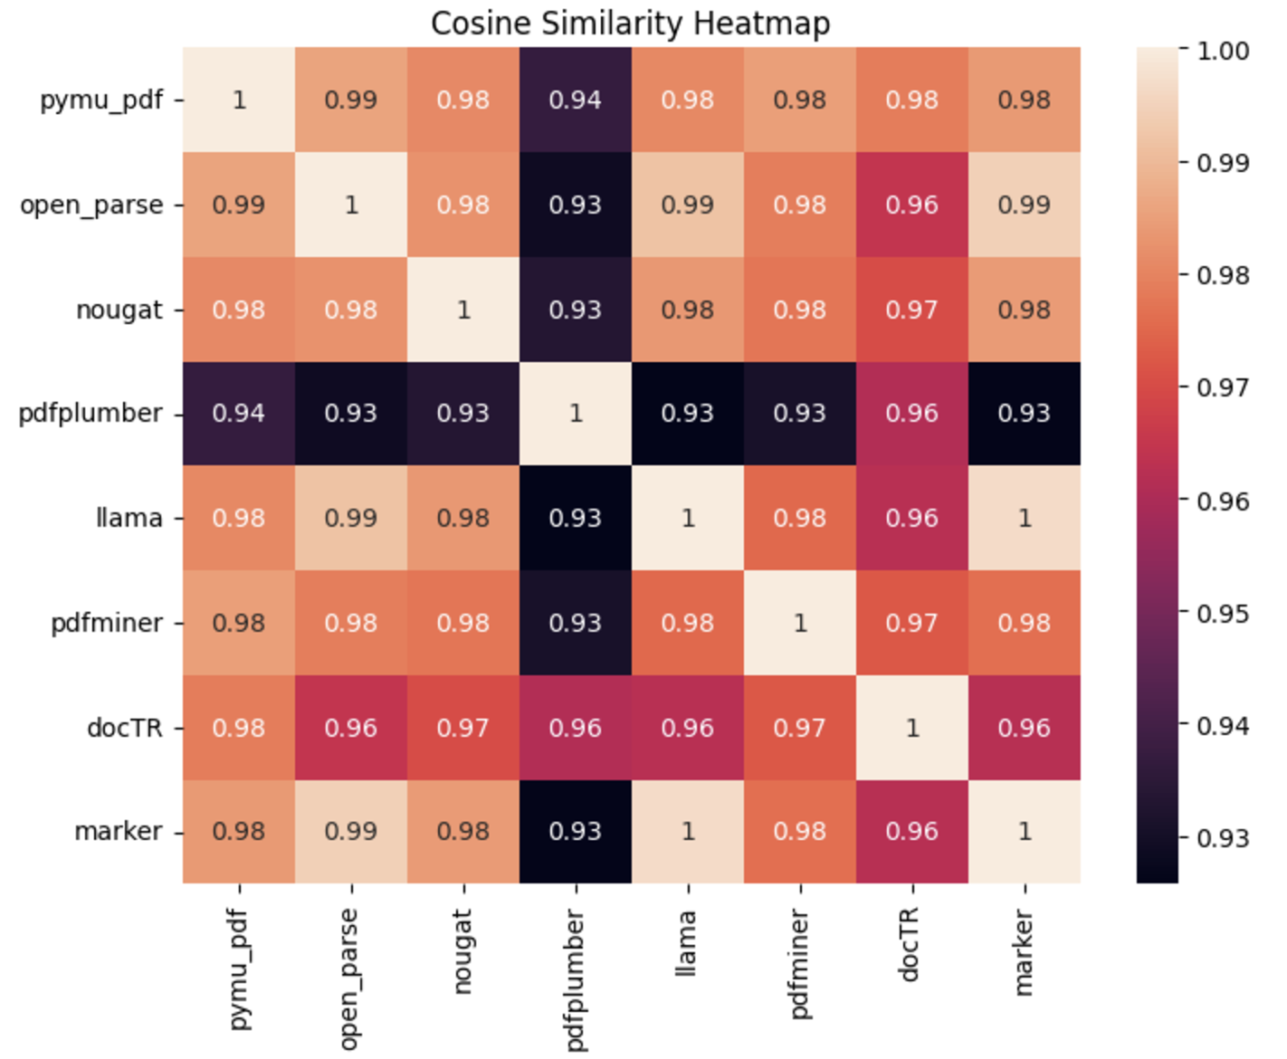
Similarity Between Model Embeddings
Issue: no ground truth given for entire PDFs
Instead, comparing between parsers themselves
Future possibility: arXiv’s HTML feature
Notes:
ivy

Slide 29

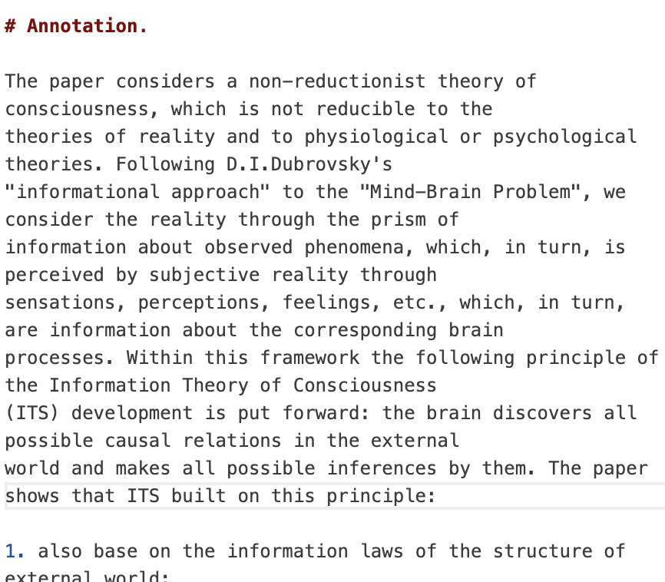
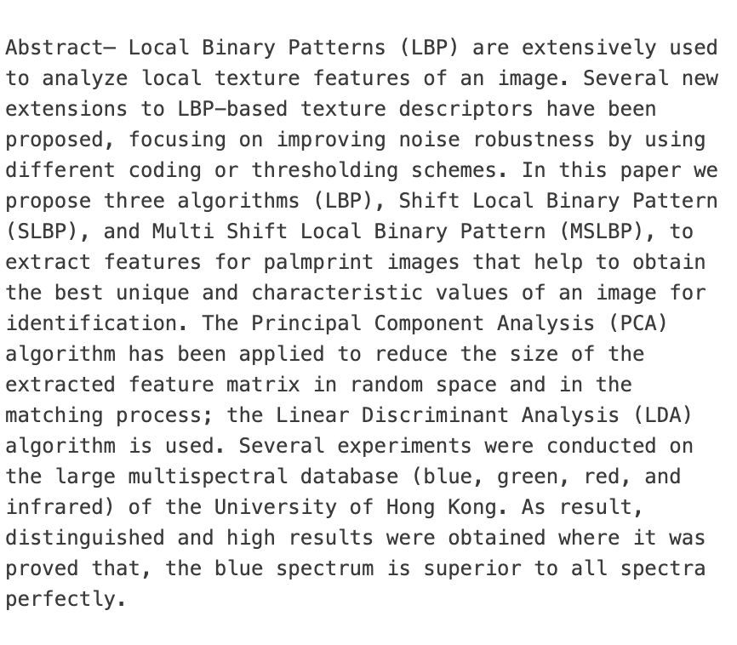
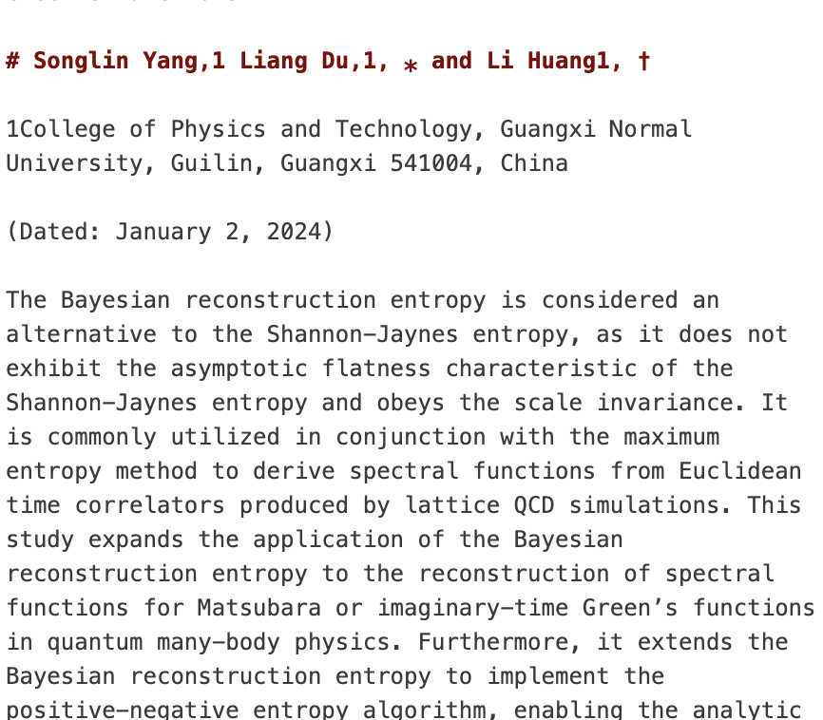
Accuracy Considerations
Inconsistent formatting of abstracts leads to difficult extraction
Abstracts are “easier” than the rest of the paper – need to assess later accuracy on whole paper
Notes:
ivy

Slide 30
Insights and Key Findings
Both OCR and AI methods were reliable with pure-text samples
Model performance was separated by handling of images, equations, and unfamiliar formatting
Minimal text differences didn’t lead to significant differences with word embeddings
Top performers: LlamaParse, PyMuPDF
Notes:
Ivy

Slide 31
04
Final Thoughts
Notes:
vivian

Slide 32
What We Learned
Building a usable training data set for a ML model often comes with hidden bottlenecks
This is especially true for open source, natural language data (like Arxiv)
Documentation and flexibility play a key role in how usable a given package is
Open source projects are providing large-scale, highly effective tools in the ML field
Notes:
Vivian
2) This can be seen as pymupdf and llamaparse were our top parsers and out of all the parsers we tested, they had the most documentation, making it easy to implement and also had the most flexibility in what they could parse out.
3) Despite how well traditional parsers work, there are multiple open source projects that are providing large-scale, highly effective tools in the ML field.

Slide 33
Skills We Learned
Operating in a fully remote work environment
Using Notebooks Hub in conjunction with GitHub and external Python libraries
Working with large bases of text and JSON data via arXiv
Working with open source, external Python libraries for novel approaches to PDF parsing
Notes:
nicole

Slide 34
Potential Next Steps
Evaluate parsing techniques for entire papers, not just abstracts
Assess importance of equations and tables in word embeddings
Determine necessary degree of accuracy in parsing to still obtain meaningful embeddings
Notes:
Kushal:
Find an alternative method to access the accuracy of the equations and tables.
so, while ideally our degree if accuracy will be 100%, that is not reasonable, so we need to consider the percent of accuracy in parsing while still holding the meaning of the text.

Slide 35
Thank you!
Questions?

